Slide 1
DATABASE SECURITY

Slide 2

PRESENTERS Wajeeha Saqib BSIT-M2-20-45 Zara Fatima BSIT-M2-20-63

Slide 3

What is Database Security?
Database:
It is a collection of information stored in a computer.
Security:
It is being free from danger.
Database Security:
It is the mechanisms that protect the database against intentional
or accidental threats.

Slide 4
Why need of database security? Data will be easily corrupted It is important to restrict access to the database from authorized users to protect \ sensitive data.

Slide 5



Slide 6
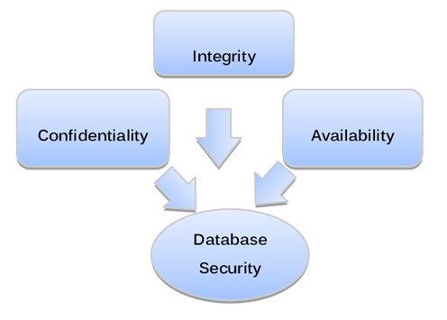
Aspects of databse security:

Slide 7
CONFIDIENTIALITY
It is protecting database from unauthorized users.
Ensures that users are allowed to do the things they are trying to do.

Slide 8
INTEGRITY
Protecting the database from authorized users.
Ensures that what are users trying to do correct.

Slide 9
AVAILABILITY
We can access our data / conduct our processing / use our communication capabilities when we want to
Authorized users should be able to access data for legal purpose as necessary

Slide 10
SECURITY PROBLEMS

Slide 11
Database Attacks:
Direct Attack
Indirect Attack

Slide 12
Active Attacks
Passive Attacks

Slide 13

Active Attack

Slide 14
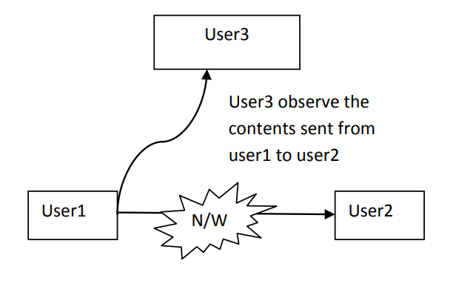
Passive Attack

Slide 15
Passive Attacks:
Static Leakage
Dynamic Leakage
Linkage Leakage

Slide 16
SQL Injection
SQL injection (SQLi) is a web security vulnerability that allows an attacker to interfere with the queries that an application makes to its database.

Slide 17
DATABASE PROTECTION REQUIREMENTS
Protection from Improper access
Protection from Inference.
Integrity of the database.
User Authentication.
Multilevel Protection.
Confinement
Management and Protection of Sensitive Data.

Slide 18
SECURITY CONTROLS

Slide 19
METHODS OF SECURING THE DATABASE
Authorization
Encryption
Authentication
Logical

Slide 20
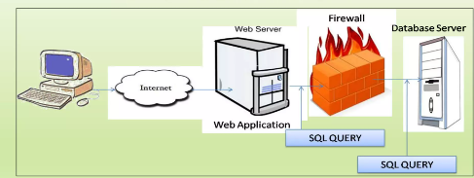
SECURITY OF THE DATABASE THROUGH FIREWALLS

Slide 21
Encryption
Data encryption enables to encrypt sensitive data, such as credit card numbers, stored in table columns.
Encrypted data is decrypted for database user who has access to the data.
Data encryption helps protect data stored on media in the event that the storage media or data file gets stolen.

Slide 22
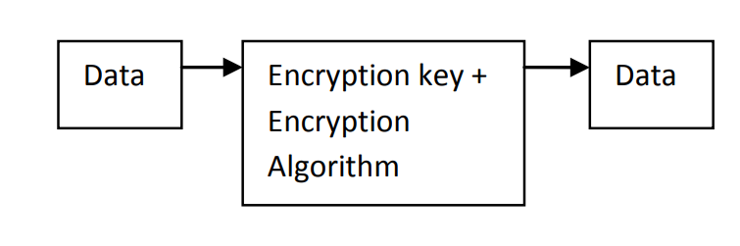

Slide 23
Authorization
Read Authorization
Insert Authorization
Update Authorization
Delete Authorization

Slide 24
Types of database Security Controls:
Flow Controls
Inference Controls
Access Control

Slide 25
Flow Control
Flow controls regulates the distribution (flow) of information among accessible objects.

Slide 26
Inference Control
Inference control aim at protecting data from indirect deletion.

Slide 27
Access Control
Access control in information system are responsible for ensuring that all direct accesses to the system objects occur base on models and rules fixed by protection policies.

Slide 28
THANK YOU

